Slide 1
HOPFIELD NETWORK
Fundamentals of neural networks by Laurene Fausett Pearson Education

Slide 2
Neural networks were designed on analogy with brain
Brain’s memory works by ASSOCIATION
Human brain has amazing capability to recall the information if a small but sufficient clue is presented.
Human beings are able to fully recall a memory by first remembering only particular aspects or features of that memory.
That is why Humans can recognize a familiar face even in an unfamiliar environment within 100-200 nsec and Hearing a few bars of music, can recall the song, scenes

Slide 3
Hopfield Network

Slide 4
Overview of Hopfield networks
Characteristics –
a recurrent network
with total connectivity and
a symmetric weight matrix;
binary valued outputs.
Advantages –
simple prescription for the weights, with no training needed;
output settles down to a steady state.

Slide 5
The Hopfield model is a
single-layered recurrent network.
Each neuron is connected to every other neuron.
All neurons act as input output
It is usually initialized with appropriate weights instead of being trained.

Slide 6

John Joseph Hopfield is an American scientist most widely known for his invention of an associative neural network in 1982. It is now more commonly known as the Hopfield Network
Professor John Hopfield
Dept. of Molecular Biology Computational Neurobiology; Biophysics
Princeton University , New jersey

Slide 7

Dr. Hopfield described a feedback network of highly interconnected neurons that could reconstruct memories from clues
and showed how stable states of network activity could represent memories

Slide 8
Hopfield Network is not primarily associated with classification.
This is the class of recurrent neural networks, i.e. with feedback connections
Rather than sending the pattern through the network from the input units to the output units, the signals cycle around in the network until the activity stabilizes.
An important concept for Hopfield networks is the energy function, a scalar function from the activity state of the network.

Slide 9
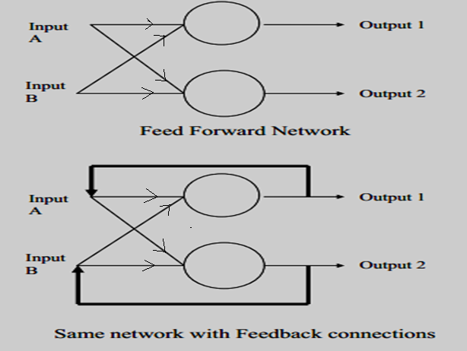

Slide 10
What Hopfield did was to add “Feedback Connections” to the network, i.e. the outputs are fed back into the inputs, and showed that with these connections the networks are capable of interesting behaviors which we might not expect of them,
that they can hold memories

Slide 11
The network structure looks as follows:
X₁
X₂
…
X_{N}

Slide 12
Two types of associative memory:
Autoassociative (Hopfield memory) and Heteroassociative.
Auto-association
retrieves a previously stored pattern that most closely resembles the current pattern.
Hetero-association
the retrieved pattern is, in general, different from the input pattern not only in content but possibly also in type and format.

Slide 13
An Associative network acts like a memory :
Autoassociation relates a pattern to itself.
An Autoassociative memory can be used to recover a clean version of a stored pattern by given a noisy pattern of that pattern
Hetroassociation is a relationship between two different patterns.
One pattern can be used as a cue to retrieve the other pattern from memory.

Slide 14
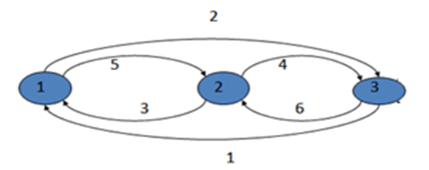
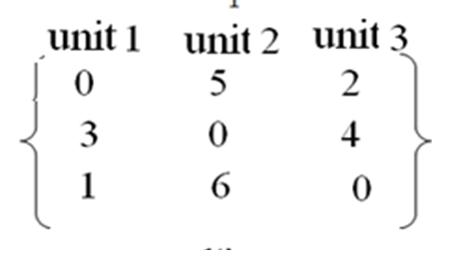
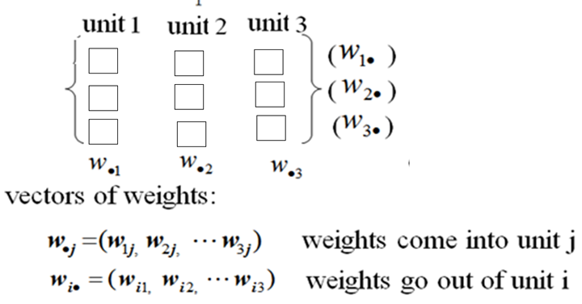
WRITE THE WEIGHT MATRIX

Slide 15
Weights are not symmetric in above network.
The constraint that weights be symmetric guarantees that the energy function decreases monotonically while following the activation rules.
A network with asymmetric weights may exhibit some periodic or chaotic behaviour;
however, Hopfield found that this behavior does not impair the network's ability to act as a content-addressable associative memory
Hopfield network working as associative memory is a content-addressable memeory (CAM) that maps a set of input patterns to a set of output patterns.

Slide 16
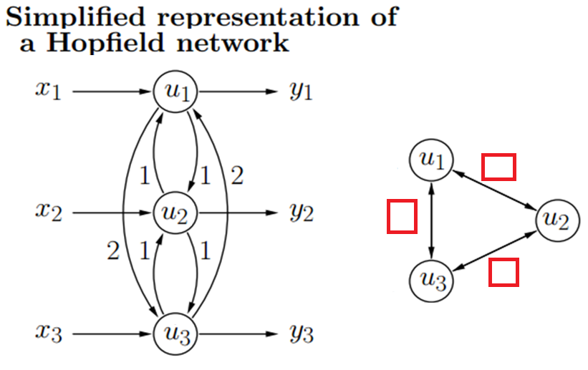
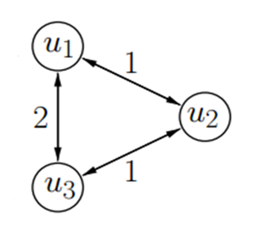
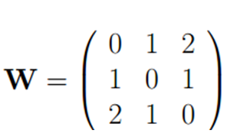
WRITE THE WEIGHT MATRIX

Slide 17
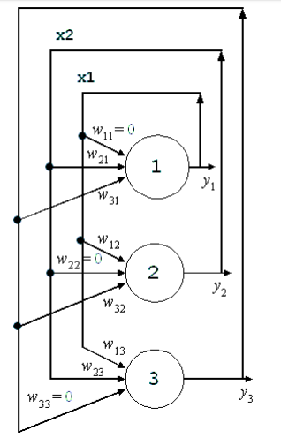

Slide 18
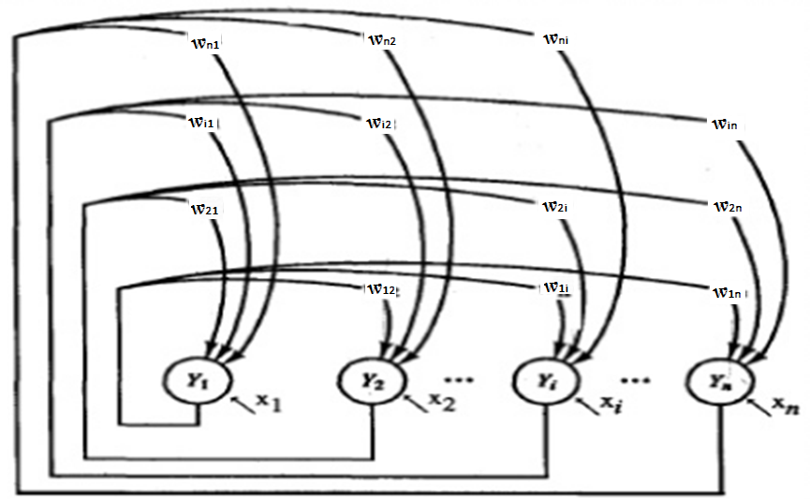

Slide 19
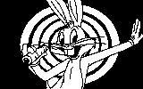
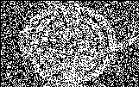
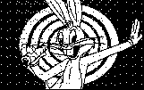
Associative memory
Associative memory
Produces for any input pattern a similar stored pattern
Retrieval by part of data
Noisy input can be also recognized
Original
Degraded
Reconstruction

Slide 20
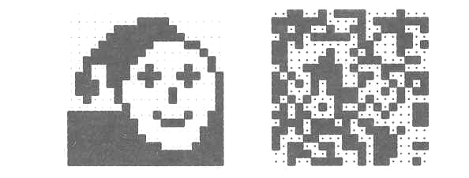
The Hopfield Network
Example: Image reconstruction (Ritter, Schulten, Martinetz 1990)
A 20×20 discrete Hopfield network was trained with 20 input patterns, including the one shown in the left figure and 19 random patterns as the one on the right.

Slide 21
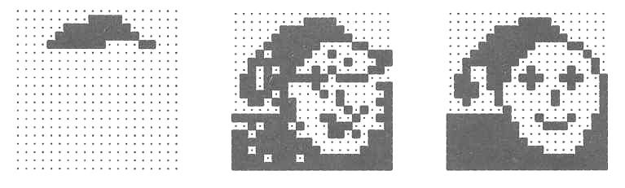
The Hopfield Network
After providing only one fourth of the “face” image as initial input, the network is able to perfectly reconstruct that image within only two iterations.

Slide 22
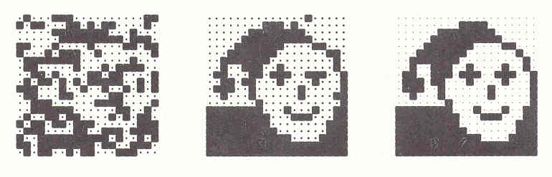
The Hopfield Network
Adding noise by changing each pixel with a probability p = 0.3 does not impair the network’s performance.
After two steps the image is perfectly reconstructed.

Slide 23
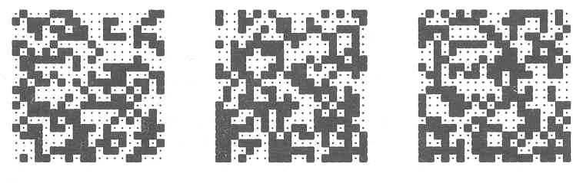
The Hopfield Network
However, for noise created by p = 0.4, the network is unable the original image.
Instead, it converges against one of the 19 random patterns.

Slide 24
The Hopfield Network
The Hopfield model constitutes an interesting neural approach to identifying partially occluded objects and objects in noisy images.
These are among the toughest problems in computer vision.

Slide 25
Discrete Hopfield Network
A Hopfield network which operates in a discrete line fashion has input and output patterns either binary (0,1) or bipolar (+1, -1) in nature.
The network has symmetrical weights with no self-connections i.e., w_{ij} = w_{ji} and w_{ii} = 0.

Slide 26
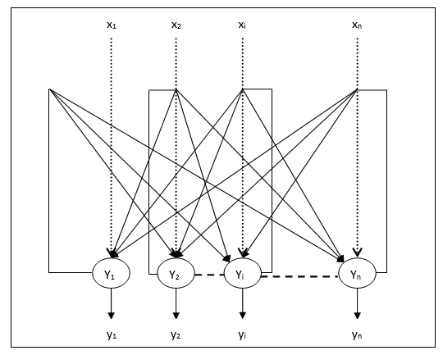

Slide 27
The weights for a Hopfield network are determined directly from the training data without need for training
To store patterns s(p), p=1,2,…P
bipolar:
same as Hebbian rule (with zero diagonal)
binary:
converting s(p) to bipolar [ make 0 -→ -1 ] when constructing W.
s(p)=( s₁(p),…..s_{i}(p),….s_{n}(p)) n dimensional P patterns

Slide 28

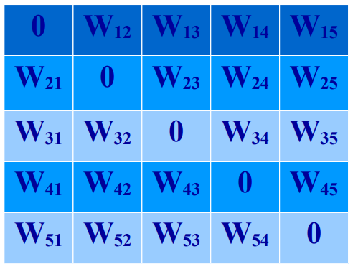
WEIGHT MATRIX TO STORE V¹ = 01101 , V₁ = 0, V₂ = 1, V₃ = 1, V₄ = 0, and V₅ = 1.

Slide 29
WEIGHT MATRIX TO STORE FIRST PATTERN V¹ = 01101 , V₁ = 0, V₂ = 1, V₃ = 1, V₄ = 0, and V₅ = 1.
W_{ij} = (2V_{i} - 1)(2V_{j} - 1) = (2V_{j} - 1)(2V_{i} - 1) = W_{ji}
 | W₁₂ = (2V₁ - 1)(2V₂ - 1) = (0 - 1)(2 - 1) = (-1)(1) = -1 W₁₃ = (2V₁ - 1)(2V₃ - 1) = (0 - 1)(2 - 1) = (-1)(1) = -1 W₁₄ = (2V₁ - 1)(2V₄ - 1) = (0 - 1)(0 - 1) = (-1)(-1) = 1 W₁₅ = (2V₁ - 1)(2V₅ - 1) = (0 - 1)(2 - 1) = (-1)(1) = -1 W₂₃ = (2V₂ - 1)(2V₃ - 1) = (2 - 1)(2 - 1) = (1)(1) = 1 W₂₄ = (2V₂ - 1)(2V₄ - 1) = (2 - 1)(0 - 1) = (1)(-1) = -1 W₂₅ = (2V₂ - 1)(2V₅ - 1) = (2 - 1)(2 - 1) = (1)(1) = 1 W₃₄ = (2V₃ - 1)(2V₄ - 1) = (2 - 1)(0 - 1) = (1)(-1) = -1 W₃₅ = (2V₃ - 1)(2V₅ - 1) = (2 - 1)(2 - 1) = (1)(1) = 1 W₄₅ = (2V₄ - 1)(2V₅ - 1) = (0 - 1)(2 - 1) = (-1)(1) = -1
Replace 0 by -1 V = (0 1 1 01 1) becomes ( -1 1 1 -1 1 1) and find weights

Slide 30
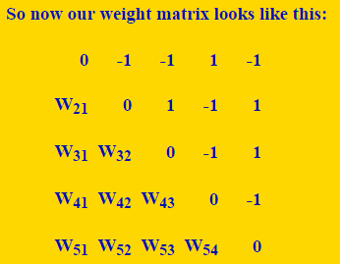
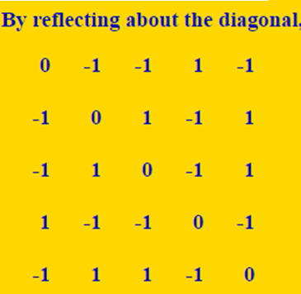
WEIGHT MATRIX FOR storing first vector : 0 1 1 0 1

Slide 31
Repeat for second pattern and then add two weight matrices
WEIGHT MATRIX TO STORE V² = 10101 , V₁ = 1, V₂ =0, V₃ = 1, V₄ = 0, and V₅ = 1.
W_{ij} = (2V_{i} - 1)(2V_{j} - 1) = (2V_{j} - 1)(2V_{i} - 1) = W_{ji}
 | W₁₂ = (2V₁ - 1)(2V₂ - 1) = (2 - 1)(0 - 1) = (1)(-1) = -1 W₁₃ = (2V₁ - 1)(2V₃ - 1) = (2 - 1)(2 - 1) = (1)(1) = 1 W₁₄ = (2V₁ - 1)(2V₄ - 1) = (2 - 1)(0 - 1) = (1)(-1) = -1 W₁₅ = (2V₁ - 1)(2V₅ - 1) = (2 - 1)(2 - 1) = (1)(1) = 1 W₂₃ = (2V₂ - 1)(2V₃ - 1) = (0 - 1)(2 - 1) = (-1)(1) = -1 W₂₄ = (2V₂ - 1)(2V₄ - 1) = (0 - 1)(0 - 1) = (-1)(-1) = 1 W₂₅ = (2V₂ - 1)(2V₅ - 1) = (0 - 1)(2 - 1) = (-1)(1) = -1 W₃₄ = (2V₃ - 1)(2V₄ - 1) = (2 - 1)(0 - 1) = (1)(-1) = -1 W₃₅ = (2V₃ - 1)(2V₅ - 1) = (2 - 1)(2 - 1) = (1)(1) = 1 W₄₅ = (2V₄ - 1)(2V₅ - 1) = (0 - 1)(2 - 1) = (-1)(1) = -1
Replace 0 by -1 V = (1 0 1 0 1) becomes ( 1 -1 1 -1 1) and find weights

Slide 32
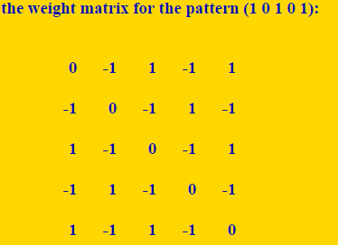

Slide 33
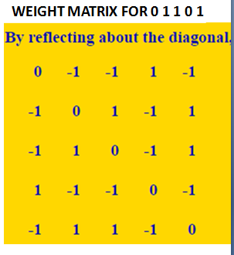
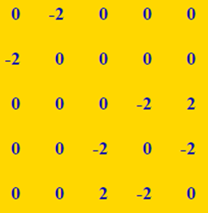
ADDITION GIVES WEIGHT MATRIX TO STORE TWO PATTERNS AS :

Slide 34
ANOTHER METHOD

Slide 35


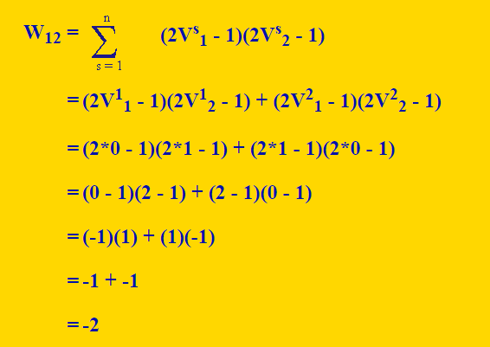

Slide 36
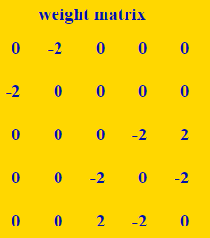
node 1 node 2 node 3 node 4 node 5

Slide 37
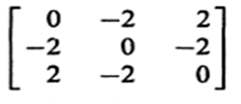
Node 1 Node 2 Node 3
w₁₂ : product of first and second columns
W₃₂ : product of third and second column
So would be symmetric

Slide 38
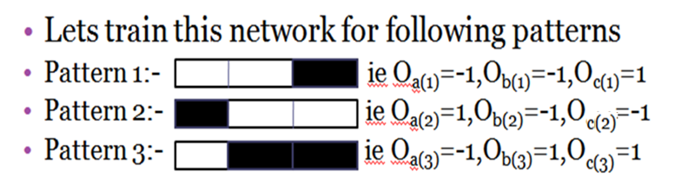
Node 1 Node 2 Node 3

Slide 39
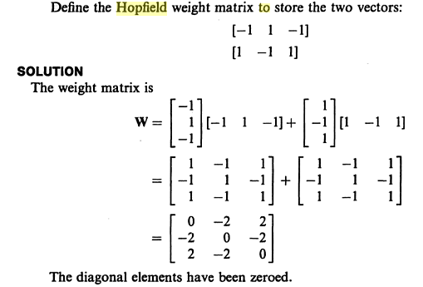
ANOTHER METHOD

Slide 41
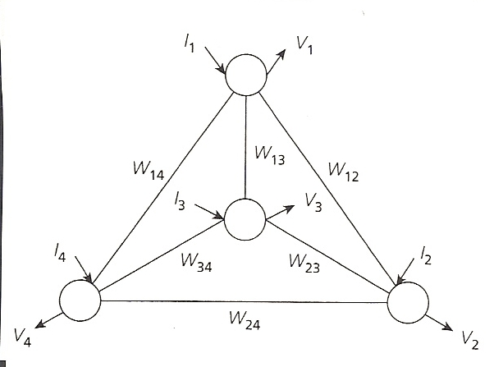
Find the weight matrix to store
(1 1 1 1) and
(–1 –1 –1 –1)
And test the state when cued with
(1 -1 1 1)
The sum over the two patterns of V_{i}V_{j} for each weight is always 1 + 1 = 2

Slide 42
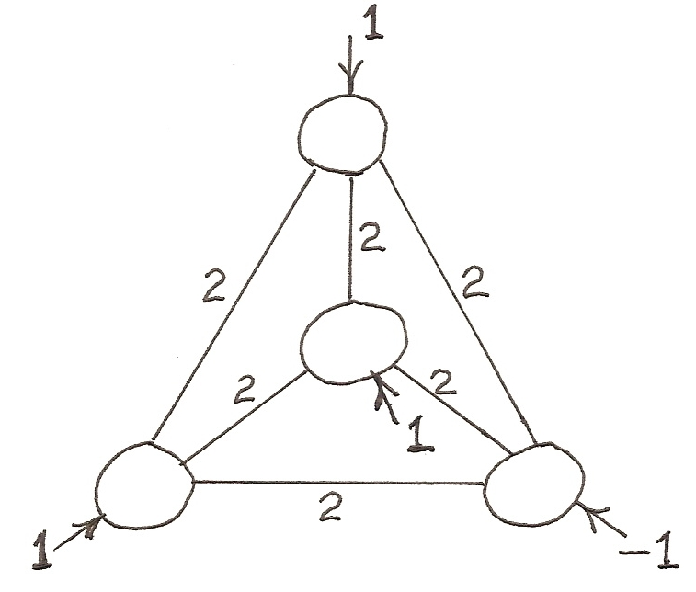
(1,1,1,1) and (-1,-1,-1,-1) are stored patterns.
Input (1,-1,1,1). Randomly select node to update. Always stabilizes to (1,1,1,1).
Input (-1,1,-1,1). Stable pattern then depends on which node is selected first to update.

Slide 43
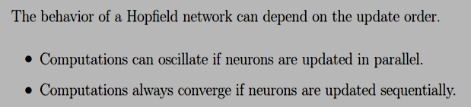
When a “cue” – noisy pattern is given, there are now two ways to update the nodes:
Asynchronously: At each point in time, update one node chosen randomly or according to some rule, like even nodes/odd nodes.
Asynchronous updating is more biologically realistic
Synchronously: Every time, update all nodes together.

Slide 44
node 1 node 2 node 3 node 4 node 5

Slide 45






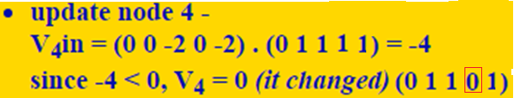
Testing again give 3,1,5,2,4,if no change-converged
Unchanged
N1 N2 N3 N4 N5
One of the stable states !

Slide 46



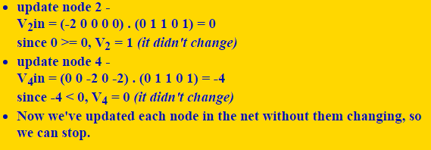
Testing again give 3,1,5,2,4
Arrived at Stable state 1

Slide 47
given the weight matrix for a 5 node network with (0 1 1 0 1) and
(1 0 1 0 1) as attractors, start at the state (1 1 1 1 1) and see where it goes. using a fixed node updating order of 2, 4, 3, 5, 1, 2, 4, 3, 5, 1(testing), etc.
update node 2 - V₂in = (-2 0 0 0 0) . (1 1 1 1 1) = -2 since -2 < 0, V₂ = 0 (it changed) (1 0 1 1 1)
update node 4 - V₄in = (0 0 -2 0 -2) . (1 0 1 1 1) = -4 since -4 < 0, V₄ = 0 (it changed) (1 0 1 0 1 )
update node 3 - V₃in = (0 0 0 -2 2) . (1 0 1 0 1) = 2 since 2 >= 0, V₃ = 1 (it didn't change)
N1 N2 N3 N4 N5
update node 5 - V₅in = (0 0 2 -2 0) . (1 0 1 0 1) = 2 since 2 >= 0, V₅ = 1 (it didn't change)

Slide 48
update node 1 - V₁in = (0 -2 0 0 0) . (1 0 1 0 1) = 0 since 0 >= 0, V₁ = 1 (it didn't change)
N1 N2 N3 N4 N5
Test update node 2 - V₂in = (-2 0 0 0 0) . (1 0 1 0 1) = -2 since -2 < 0, V₂ = 0 (it didn't change)
update node 4 - V₄in = (0 0 -2 0 -2) . (1 0 1 0 1) = -4 since -4 < 0, V₄ = 0 (it didn't change)
Now we've updated each node in the net without them changing, so we can stop.
Notice that with this node updating order, we went to the other attractor( Stable State 2). After converging, network will go to one of stable state
Thus, if two patterns are very similar, the order in which you update the nodes can make a difference as to which attractor the net goes to

Slide 49
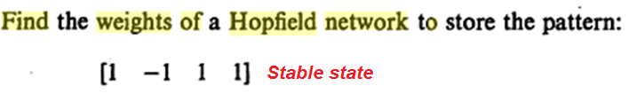
A stable network will eventually reach a condition in which the recirculated output no longer changes the network state.
What does such a stable state look like?
In each iteration, the activation pattern will be drawn towards stable state

Slide 51
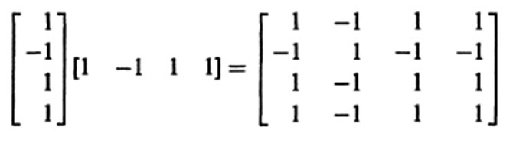
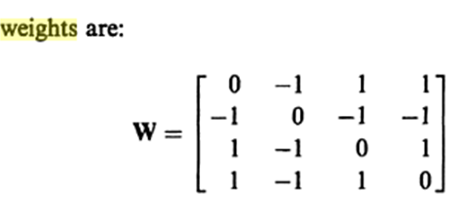
Putting Self-connection weights as 0

Slide 52
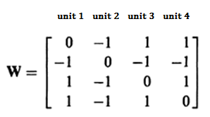
First column lists all Weights connecting to first unit, Second column lists all Weights connecting to second unit and so on..

Slide 53
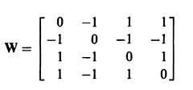
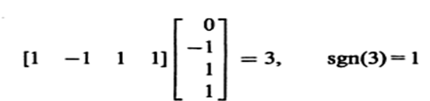
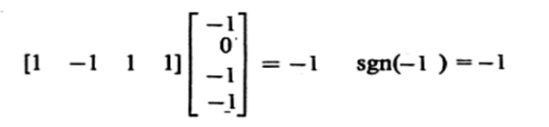
Asynchronus TESTING : First unit is updated by multiplying the cue vector with the First column in weight matrix
First Unit stays in the same state
Second unit is updated by multiplying the cue vector with the Second column in weight matrix
Second unit stays in the same state

Slide 54
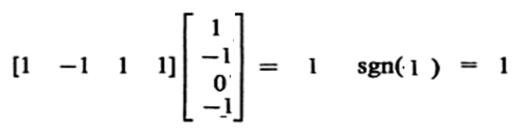
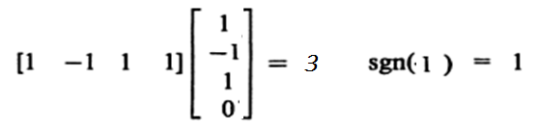
Third unit is updated by multiplying the cue vector with the Third column in weight matrix
Third unit stays in the same state
Fourth unit is updated by multiplying the cue vector with the Fourth column in weight matrix
Fourth unit stays in the same state

Slide 55

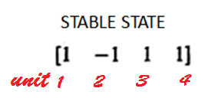
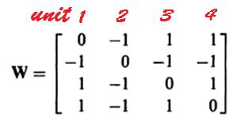
Find the stable state of Hopfield network when CUED with [ -1 -1 1 1]

Slide 56
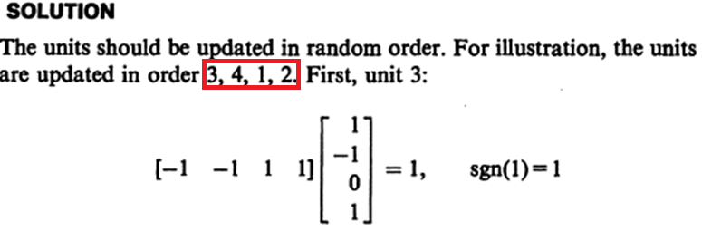
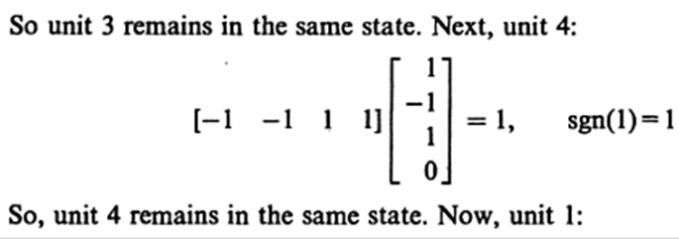
Find the stable state of Hopfield network when CUED with [ -1 -1 1 1]

Slide 57


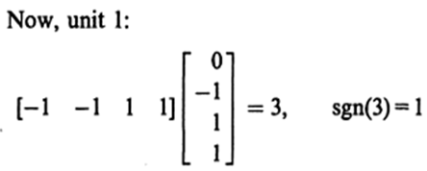
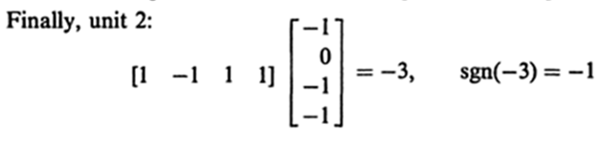


Slide 58
Hopfield Network
The state of the system is given by the activation values y = (y _{k} ).
The net input s _{k} (t +1) of a neuron k at cycle (t +1) is a weighted sum

Slide 59
Hopfield Network
A threshold function is applied to obtain the output

Slide 60
Hopfield Network
A neuron k in the net is stable at time t I.e.
A state is stable if all the neurons are stable

Slide 61
Capacity Analysis of DHM
P: maximum number of random patterns of dimension n can be stored in a DHM of n nodes
Hopfield’s observation:
Theoretical analysis:
P/n decreases because larger n leads to more interference between stored patterns.
Some work to modify HM to increase its capacity to close to n, W is trained (not computed by Hebbian rule).
In mathematics, the binary logarithm (log₂ n) is the power to which the number 2 must be raised to obtain the value n

Slide 62
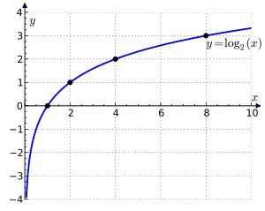
The binary logarithm is the logarithm to the base 2. The binary logarithm function is the inverse function of the power of two function.

Slide 63
Hopfield Networks
It appears, however, that the network gets saturated very quickly, and that about 0.138N memories can be stored before recall errors become severe.
If we have 56 neurons, how many patterns we can hold ??
7.728, i.e. 7 patterns

Slide 64
Energy is associated with the state of the system.
During the recall phase of the Hopfield network the activity pattern strives to attain as low energy as possible, causing it to find local minima in the energy landscape, corresponding to stable patterns of activity.
A stable network will eventually reach a condition in which the recirculated output no longer changes the network state.

Slide 65
Example:ENERGY Method 1 of calculating Weights

Slide 66
Method 2 of calculating Weights
1
−2
2
3
−2
4

Slide 67
Example:ENERGY CALCULATION
1
−2
2
3
−2
4
ENERGY= E(x)
E =-(1/2) [-2x₁ x₂ - 2x₂ x₁ -2x₃ x₄ -2x₄ x₃ ]
=(-1/2) [-4[x₁ x₂ +x₄ x₃ ] = 2[x₁ x₂ +x₄ x₃ ]
½ is just a scaling factor
Energy for pattern 1 ( 1, -1, -1, 1) = 2( -1-1) = -4
Energy for pattern 2 ( -1, 1, -1, 1) = 2 ( -1-1) = -4

Slide 68
1
−2
2
3
−2
4
1
1
−1
−1
Unit 1 has changed from stable state
Unit 4 has changed from stable state
E=4
−1
1
Stable
−1
−1
E=0
−1
1
−1
1
E=−4

Slide 69
ENERGY FOR BAM
-0.5 [X W Y^{T} + Y W^{T} X^{T} ]

Slide 70
END

